Slide 1
SPRINT 1

Slide 2
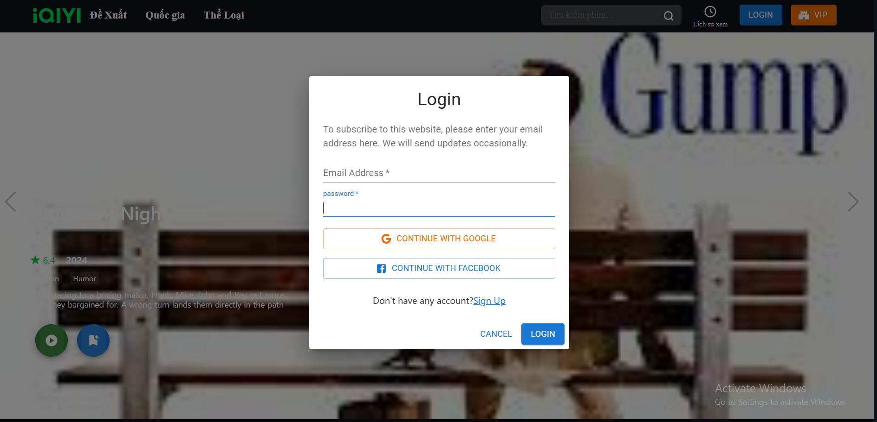
SPRINT 1

Slide 3
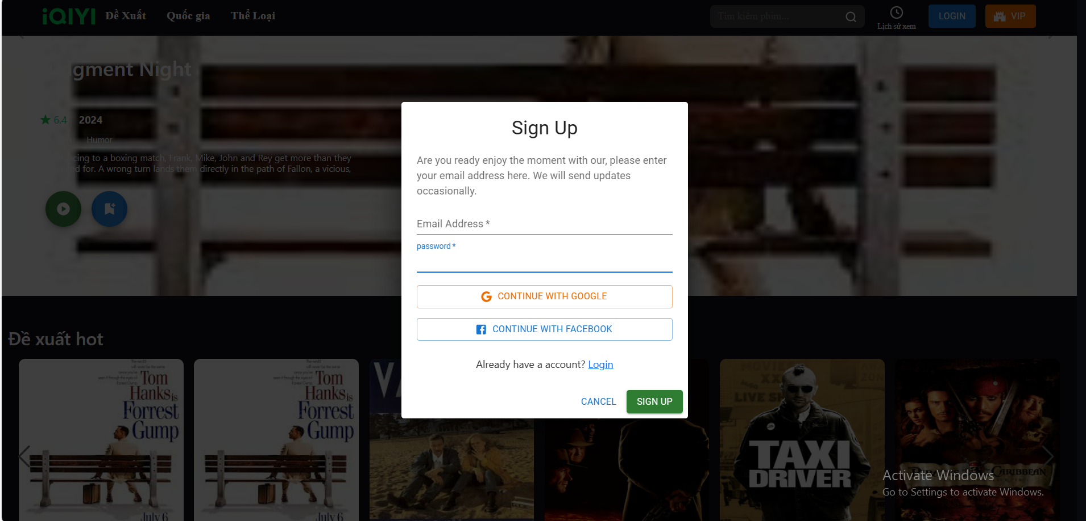
SPRINT 1

Slide 4
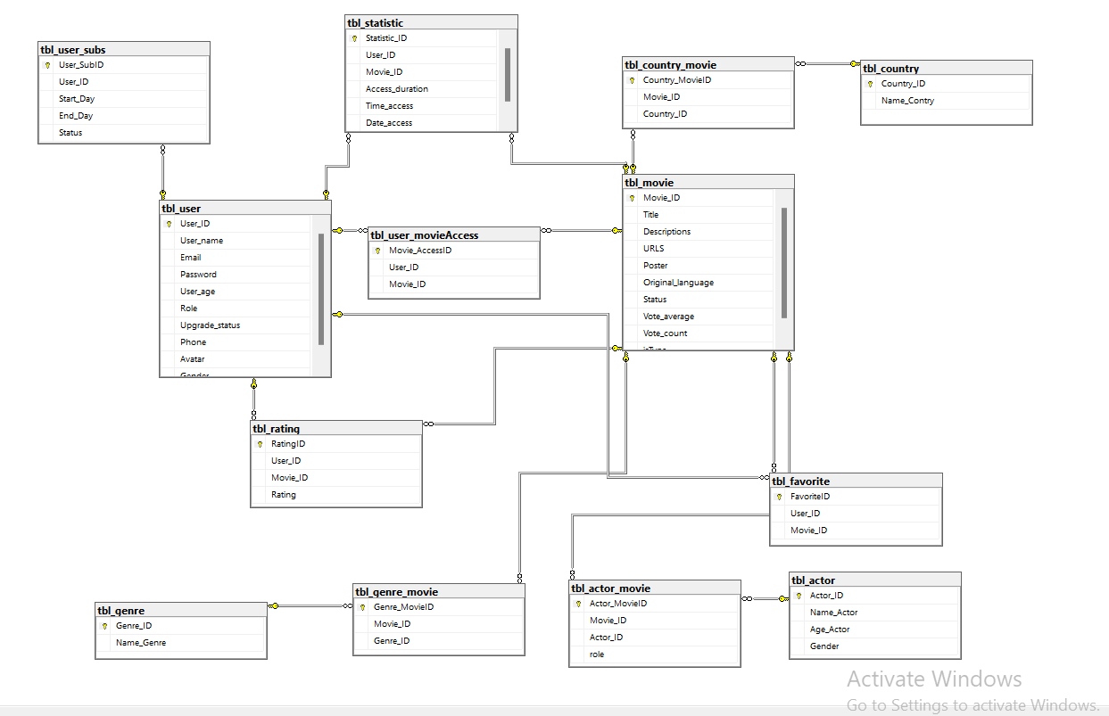
SPRINT 1

Slide 5
SPRINT 1

